Slide 1

Directx Sound
Amplitude Modualtion
Name : Remon Botrous
Section : 2
Under Supervision : Dr. khaled

Slide 2
Amplitude Modulation
AM used to play a wave in a Directxsound second buffer.
AM show how to apply effects to Directxsound secondary buffer and modify the parameter of the effect

Slide 3
DSEFFECTDESC Structure
The DSEFFECTDESC structure describes an effect associated with a buffer
The application takes the following steps to set an effect on a buffer and change its parameter :
1- Creates the buffer with the DSBCAPS_CTRLFX flag.
2- Describe the effect in a SEFFECTDESC structure, setting the guidDSFXClass member to the GUID of the effect desired.
.

Slide 4
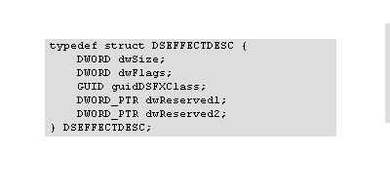
Members
dwSize
  Size of the structure, in bytes.
dwFlags
  Flags. Can be zero or one of the following values.
  1- DSFX_LOCHARDWAR E Effect must be in hardware.
  2-DSFX_LOCSOFTWARE Effect must be in software, even if the hardware supports acceleration of guidDSFXClass.
  guidDSFXClass
  Class identifier of the effect.
  dwReserved1
    Reserved for future use.
    dwReserved2
    Reserved for future use.

Slide 5
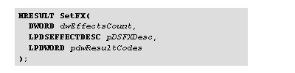
3-Passes the buffer description to IDirectSoundBuffer8::SetFX.
IDirectSoundBuffer8::SetFX
The SetFX method enables effects on a buffer.
Parameters
dwEffectsCount
  Number of elements in the pDSFXDesc and pdwResultCodes arrays.
  If this value is 0, pDSFXDesc and pdwResultCodes must both be NULL. Set to 0 to remove all effects from the buffer.
pDSFXDesc
  Address of an array of DSEFFECTDESC structures, of size dwEffectsCount, that specifies the effects wanted on the buffer. Must be NULL if dwEffectsCount is 0.
pdwResultCodes
  Address of an array of DWORD elements

Slide 6
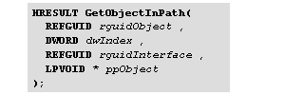
4-Calls IDirectSoundBuffer8::GetObjectInPath to get an interface pointer to the effect, in this case IDirectSoundFXGargle8.
IDirectSoundBuffer8::GetObjectInPath
The GetObjectInPath method retrieves an interface for an effect object
associated with the buffer.
Parameters
rguidObject
  Unique class identifier of the object being searched for, such As
  GUID_DSFX_STANDARD_ECHO. Set this parameter to GUID_All_Objects to search for objects of any class.
dwIndex
  Index of the object within objects of that class in the path.
rguidInterface
  Unique identifier of the desired interface.
  ppObject
  Address of a variable that receives the desired interface pointer.

Slide 7
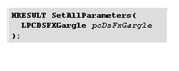
5-In the On EffectChanged function , uses
IDirectSoundFXGargle8::SetAllParameters to change the parameters
of the gargle effect.
IDirectSoundFXGargle8::SetAllParameters
The SetAllParameters method sets the amplitude modulation
parameters of a buffer.
Parameters
pcDsFxGargle
  Address of a DSFXGargle structure that specifies the effect
  parameters.

Slide 8
The application code contain the following function:
      INT APIENTRY wWinMain
    Entry point for the application. Since we use a simple dialog
    for user interaction we don't need to pump messages.
    2. INT_PTR CALLBACK MainDlgProc
    Handles dialog messages.
    3. VOID OnInitDialog( HWND hDlg )
    Initializes the dialogs (sets up UI controls, etc.).
    4. VOID OnOpenSoundFile( HWND hDlg )
    Called when the user requests to open a sound file
    5. HRESULT ValidateWaveFile( HWND hDlg, TCHAR* strFileName )
    Open the wave file with the helper class CWaveFile to make
    sure it is valid
    6. HRESULT OnPlaySound( HWND hDlg )
    User hit the "Play" button.

Slide 9
    7. VOID OnTimer( HWND hDlg )
    When we think the sound is playing this periodically checks to see
    if the sound has stopped. If it has then updates the dialog.
    8. VOID OnEffectChanged( HWND hDlg )
    Called when the UI prompted an effect change.
    9. VOID EnablePlayUI( HWND hDlg, BOOL bEnable )
    Enables or disables the Play UI controls.

Slide 10
The two main function:
1-onplay function
  This function is called when the user hit the play button.
  when the user hit the play button the buffer of diretxsound is
  created only with the CTRLFX control And free any previous sound
  file.
  Since the user can change the focus before the sound is played, we
need to create the sound buffer every time the play button is
pressed.
  Query IDirectSoundBuffer8 interface.
  Set gargle effect on the IDirectSoundBuffer8.
  Get gargle effect friendly interface
  Play the sound.
  Update the UI controls to show the sound as playing.

Slide 11
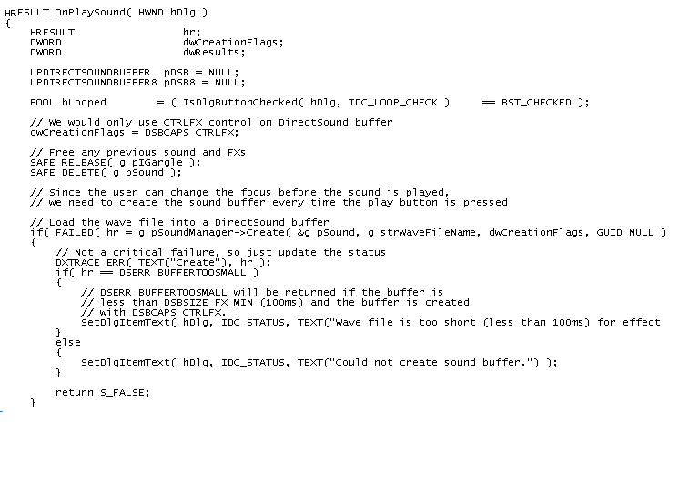

Slide 12
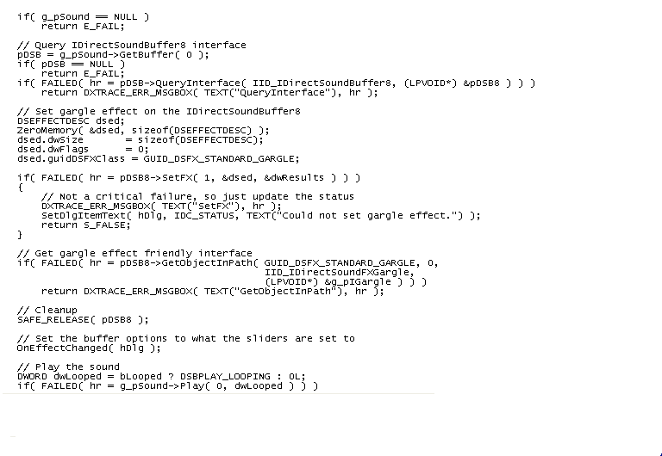

Slide 13
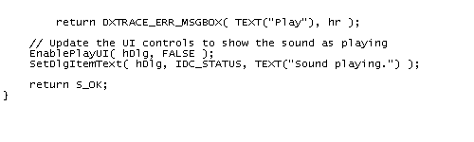
The second main function is:
On effect changed
    Called when the UI prompted an effect change.
    Update UI.
    Get wave form.
    Set the options in the DirectSound buffer.

Slide 14
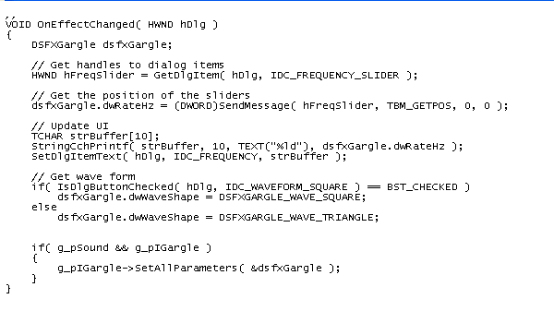

Slide 15
Thank you

